Slide 1
I/O Management and Disk Scheduling
Chapter 11

Slide 2
Categories of I/O Devices
Human readable
  Used to communicate with the user
  Printers
  Video display terminals
    Display
    Keyboard
    Mouse

Slide 3
Categories of I/O Devices
Machine readable
  Used to communicate with electronic equipment
  Disk and tape drives
  Sensors
  Controllers
  Actuators

Slide 4
Categories of I/O Devices
Communication
  Used to communicate with remote devices
  Digital line drivers
  Modems

Slide 5
Differences in I/O Devices
Data rate
  May be differences of several orders of magnitude between the data transfer rates

Slide 6
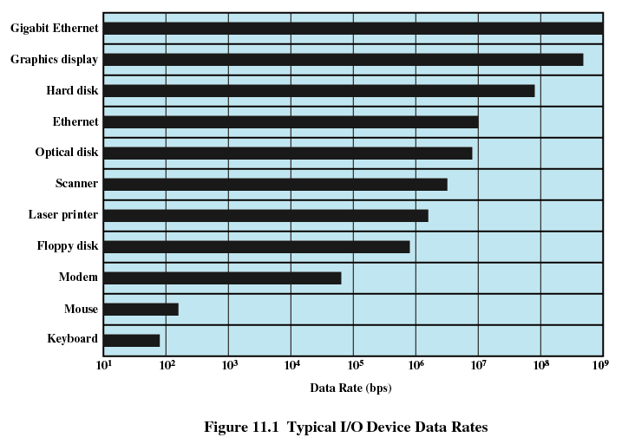

Slide 7
Differences in I/O Devices
Application
  Disk used to store files requires file management software
  Disk used to store virtual memory pages needs special hardware and software to support it
  Terminal used by system administrator may have a higher priority

Slide 8
Differences in I/O Devices
Complexity of control
Unit of transfer
  Data may be transferred as a stream of bytes for a terminal or in larger blocks for a disk
Data representation
  Encoding schemes
Error conditions
  Devices respond to errors differently

Slide 9
Performing I/O
Programmed I/O
  Process is busy-waiting for the operation to complete
Interrupt-driven I/O
  I/O command is issued
  Processor continues executing instructions
  I/O module sends an interrupt when done

Slide 10
Performing I/O
Direct Memory Access (DMA)
  DMA module controls exchange of data between main memory and the I/O device
  Processor interrupted only after entire block has been transferred

Slide 11
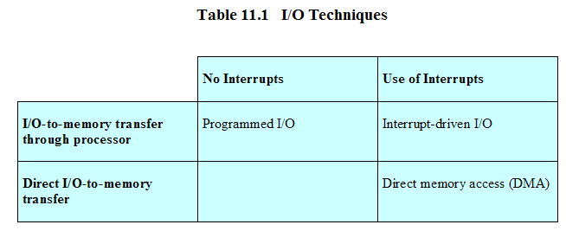
Relationship Among Techniques

Slide 12
Evolution of the I/O Function
Processor directly controls a peripheral device
Controller or I/O module is added
  Processor uses programmed I/O without interrupts
  Processor does not need to handle details of external devices

Slide 13
Evolution of the I/O Function
Controller or I/O module with interrupts
  Processor does not spend time waiting for an I/O operation to be performed
Direct Memory Access
  Blocks of data are moved into memory without involving the processor
  Processor involved at beginning and end only

Slide 14
Evolution of the I/O Function
I/O module is a separate processor
I/O processor
  I/O module has its own local memory
  Its a computer in its own right

Slide 15
Direct Memory Access
Processor delegates I/O operation to the DMA module
DMA module transfers data directly to or form memory
When complete DMA module sends an interrupt signal to the processor

Slide 16
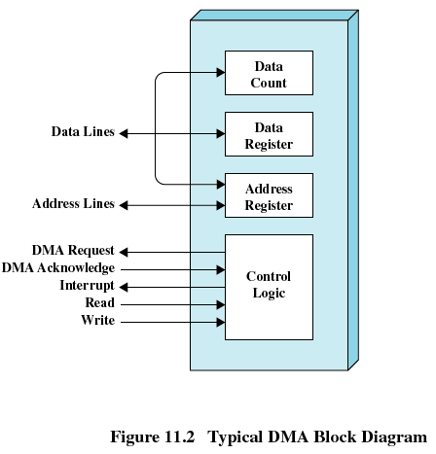
DMA

Slide 17
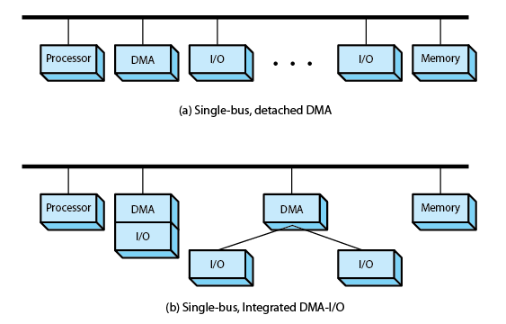
DMA Configurations

Slide 18
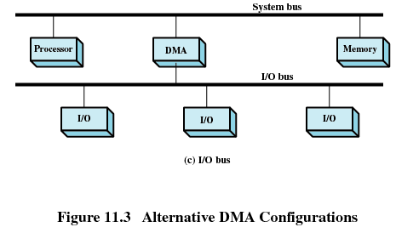
DMA Configurations

Slide 19
Operating System Design Issues
Efficiency
  Most I/O devices extremely slow compared to main memory
  Use of multiprogramming allows for some processes to be waiting on I/O while another process executes
  I/O cannot keep up with processor speed
  Swapping is used to bring in additional Ready processes which is an I/O operation

Slide 20
Operating System Design Issues
Generality
  Desirable to handle all I/O devices in a uniform manner
  Hide most of the details of device I/O in lower-level routines so that processes and upper levels see devices in general terms such as read, write, open, close, lock, unlock

Slide 21
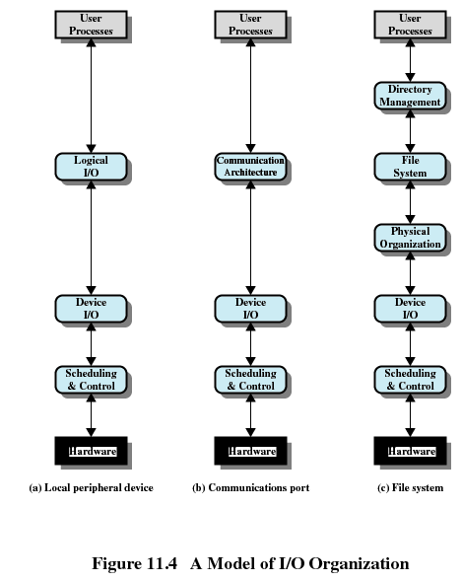

Slide 22
I/O Buffering
Reasons for buffering
  Processes must wait for I/O to complete before proceeding
  Certain pages must remain in main memory during I/O

Slide 23
I/O Buffering
Block-oriented
  Information is stored in fixed sized blocks
  Transfers are made a block at a time
  Used for disks and tapes
Stream-oriented
  Transfer information as a stream of bytes
  Used for terminals, printers, communication ports, mouse and other pointing devices, and most other devices that are not secondary storage

Slide 24
Single Buffer
Operating system assigns a buffer in main memory for an I/O request
Block-oriented
  Input transfers made to buffer
  Block moved to user space when needed
  Another block is moved into the buffer
    Read ahead

Slide 25
Single Buffer
Block-oriented
  User process can process one block of data while next block is read in
  Swapping can occur since input is taking place in system memory, not user memory
  Operating system keeps track of assignment of system buffers to user processes

Slide 26
Single Buffer
Stream-oriented
  Used a line at time
  User input from a terminal is one line at a time with carriage return signaling the end of the line
  Output to the terminal is one line at a time

Slide 27
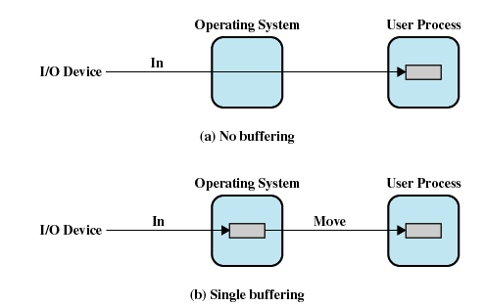
I/O Buffering

Slide 28
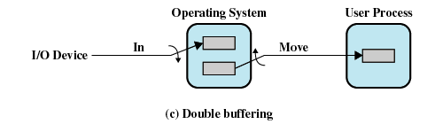
Double Buffer
Use two system buffers instead of one
A process can transfer data to or from one buffer while the operating system empties or fills the other buffer

Slide 29
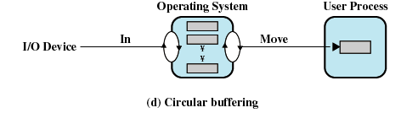
Circular Buffer
More than two buffers are used
Each individual buffer is one unit in a circular buffer
Used when I/O operation must keep up with process

Slide 30
Disk Performance Parameters
To read or write, the disk head must be positioned at the desired track and at the beginning of the desired sector
Seek time
  Time it takes to position the head at the desired track
Rotational delay or rotational latency
  Time its takes for the beginning of the sector to reach the head

Slide 31
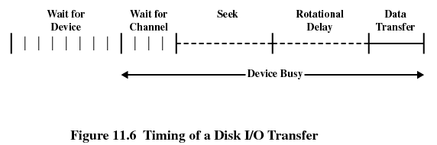
Timing of a Disk I/O Transfer

Slide 32
Disk Performance Parameters
Access time
  Sum of seek time and rotational delay
  The time it takes to get in position to read or write
Data transfer occurs as the sector moves under the head

Slide 33
Disk Scheduling Policies
Seek time is the reason for differences in performance
For a single disk there will be a number of I/O requests
If requests are selected randomly, we will poor performance

Slide 34
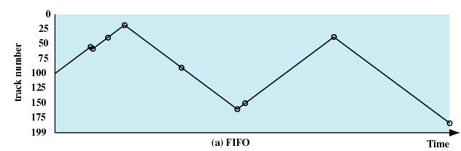
Disk Scheduling Policies
First-in, first-out (FIFO)
  Process request sequentially
  Fair to all processes
  Approaches random scheduling in performance if there are many processes

Slide 35
Disk Scheduling Policies
Priority
  Goal is not to optimize disk use but to meet other objectives
  Short batch jobs may have higher priority
  Provide good interactive response time

Slide 36
Disk Scheduling Policies
Last-in, first-out
  Good for transaction processing systems
    The device is given to the most recent user so there should be little arm movement
  Possibility of starvation since a job may never regain the head of the line

Slide 37
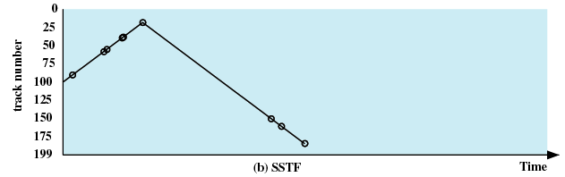
Disk Scheduling Policies
Shortest Service Time First
  Select the disk I/O request that requires the least movement of the disk arm from its current position
  Always choose the minimum Seek time

Slide 38
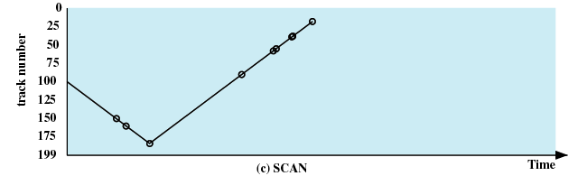
Disk Scheduling Policies
SCAN
  Arm moves in one direction only, satisfying all outstanding requests until it reaches the last track in that direction
  Direction is reversed

Slide 39
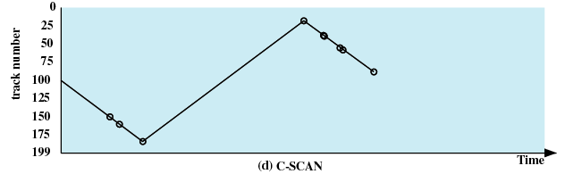
Disk Scheduling Policies
C-SCAN
  Restricts scanning to one direction only
  When the last track has been visited in one direction, the arm is returned to the opposite end of the disk and the scan begins again

Slide 40
Disk Scheduling Policies
N-step-SCAN
  Segments the disk request queue into subqueues of length N
  Subqueues are processed one at a time, using SCAN
  New requests added to other queue when queue is processed
FSCAN
  Two queues
  One queue is empty for new requests

Slide 41
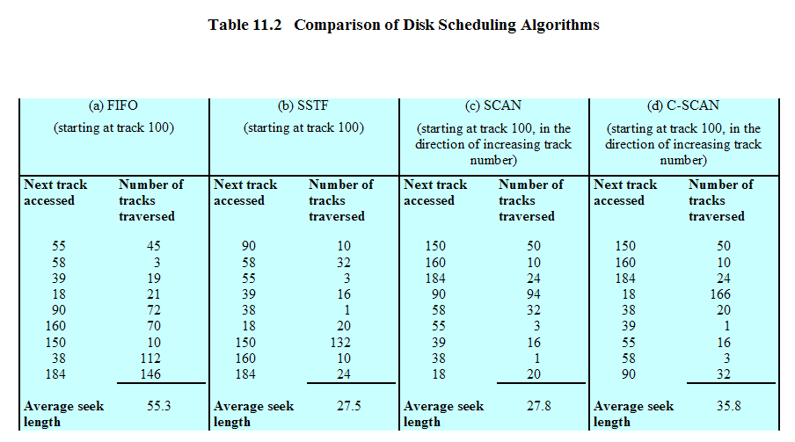
Disk Scheduling Algorithms

Slide 42
RAID
Redundant Array of Independent Disks
Set of physical disk drives viewed by the operating system as a single logical drive
Data are distributed across the physical drives of an array
Redundant disk capacity is used to store parity information

Slide 43
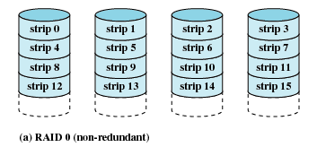
RAID 0 (non-redundant)

Slide 44
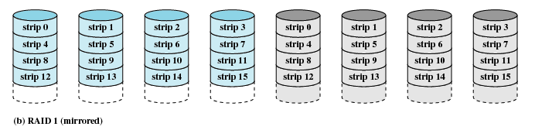
RAID 1 (mirrored)

Slide 45
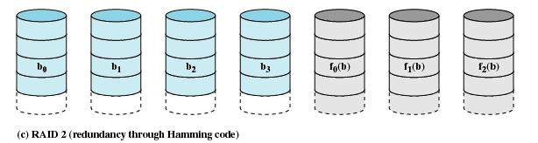
RAID 2 (redundancy through Hamming code)

Slide 46
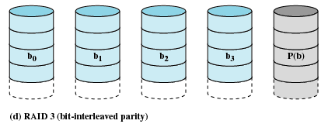
RAID 3 (bit-interleaved parity)

Slide 47
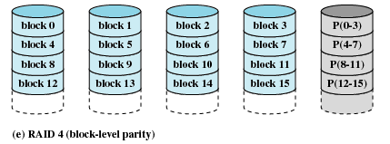
RAID 4 (block-level parity)

Slide 48
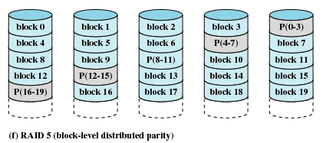
RAID 5 (block-level distributed parity)

Slide 49
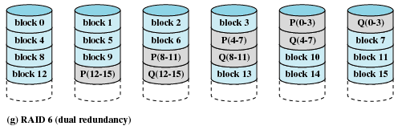
RAID 6 (dual redundancy)

Slide 50
Disk Cache
Buffer in main memory for disk sectors
Contains a copy of some of the sectors on the disk

Slide 51
Least Recently Used
The block that has been in the cache the longest with no reference to it is replaced
The cache consists of a stack of blocks
Most recently referenced block is on the top of the stack
When a block is referenced or brought into the cache, it is placed on the top of the stack

Slide 52
Least Recently Used
The block on the bottom of the stack is removed when a new block is brought in
Blocks don’t actually move around in main memory
A stack of pointers is used

Slide 53
Least Frequently Used
The block that has experienced the fewest references is replaced
A counter is associated with each block
Counter is incremented each time block accessed
Block with smallest count is selected for replacement
Some blocks may be referenced many times in a short period of time and the reference count is misleading

Slide 54
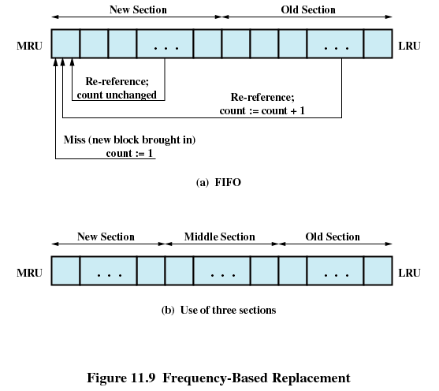

Slide 55
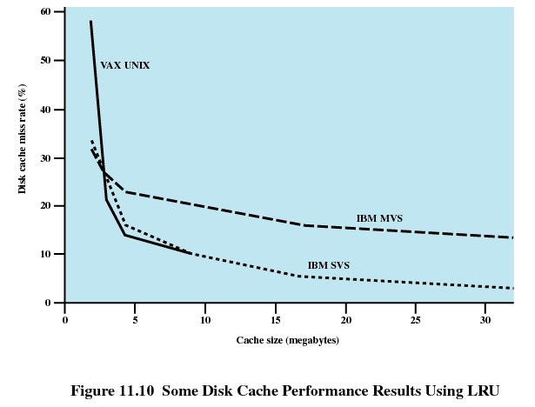

Slide 56
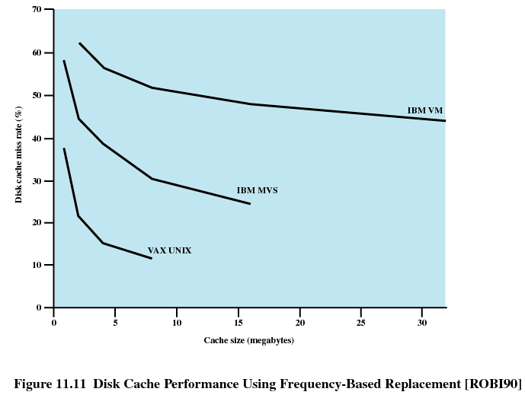

Slide 57
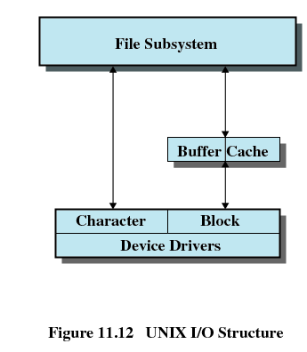
UNIX SCR4 I/O
Each individual device is associated with a special file
Two types of I/O
  Buffered
  Unbuffered

Slide 58
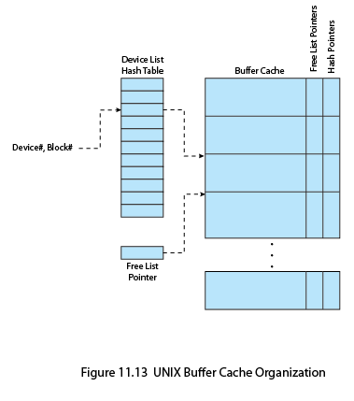

Slide 59
Linux I/O
Elevator scheduler
  Maintains a single queue for disk read and write requests
  Keeps list of requests sorted by block number
  Drive moves in a single direction to satisy each request

Slide 60
Linux I/O
Deadline scheduler
  Uses three queues
    Incoming requests
    Read requests go to the tail of a FIFO queue
    Write requests go to the tail of a FIFO queue
  Each request has an expiration time

Slide 61
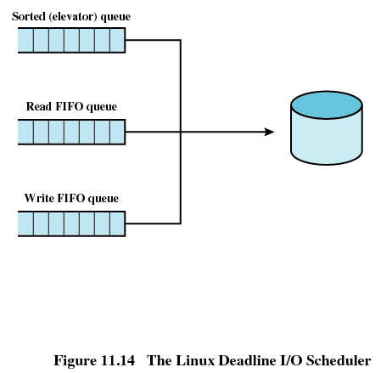
Linux I/O

Slide 62
Linux I/O
Anticipatory I/O scheduler
  Delay a short period of time after satisfying a read request to see if a new nearby request can be made

Slide 63
Windows I/O
Basic I/O modules
  Cache manager
  File system drivers
  Network drivers
  Hardware device drivers

Slide 64
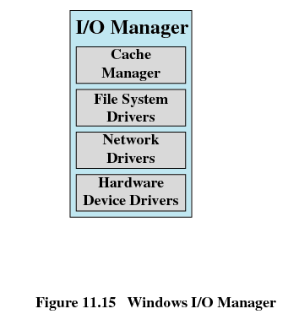
Windows I/O

